Slide 1
Software Engineering
Dr. Syed Muazzam Ali Shah

Slide 2
Course Outline
Weeks | Topics
1 | Introduction
2 | Software Process and Process Models
3 | Agile
4 | Requirement Engineering
5 | WBS, Wideband Delphi estimation method
6 | Mid Term 1
7 | Design concepts
8 | Architectural Design
9 | UI Design
10 | Software Testing
11 | Mid Term 2
12 | Quality Management
13 | Estimation for software projects
14 | Project Scheduling and Risk management
15 | Projects and Reviews
16 | Final

Slide 3
Assessment Criteria
Evaluation | Marks Distribution
Mids I & II | 30 Marks (15 each)
Project | 10 Marks (Proposal 2 marks, Presentation 2 marks, Report 2 marks, running software 4 marks)
Quizzes (best 3 out of 4) | 6 Marks
Assignments | 4 Marks
Final | 50 Marks

Slide 4
Tentative Project Deadlines
Project Proposal & Group Members’ name submission
(3rd week)
Idea approval (3rd Week)
Project, Viva and report submission
(Last week)

Slide 5

Books
Software Engineering, Ian Sommerville, 10th edition

Slide 6
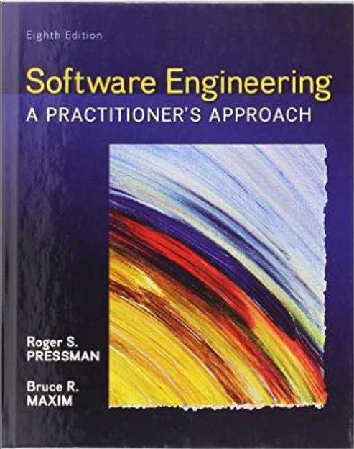
Books
Software Engineering: A practitioners approach, Roger S. Pressman (7th / 8th edition)

Slide 7
Google Classroom Code
Spring 2023-SE-BCS-6B
P3oxzc5
Email ID
muazzam.ali@nu.edu.pk

Slide 8
Course Objectives
To familiarize students to the fundamental concepts, techniques, processes, methods, and tools of software Engineering.
To help students to develop basic skills that will enable them to construct software of high quality.
Software that is reliable, and that is reasonably easy to understand , modify, and maintain.
To foster and understanding of why these skills are important.

Slide 9
Software can have huge impact in any aspect of our society.

Slide 10
Problems in software development
Some common issues.
The final software does not fulfill the needs of the customer.
Hard to extend and improve: if you want to add a functionality later its mission impossible.
Bad Documentation.
Bad Quality: frequent errors, hard to use…
More time and costs than expected.

Slide 11
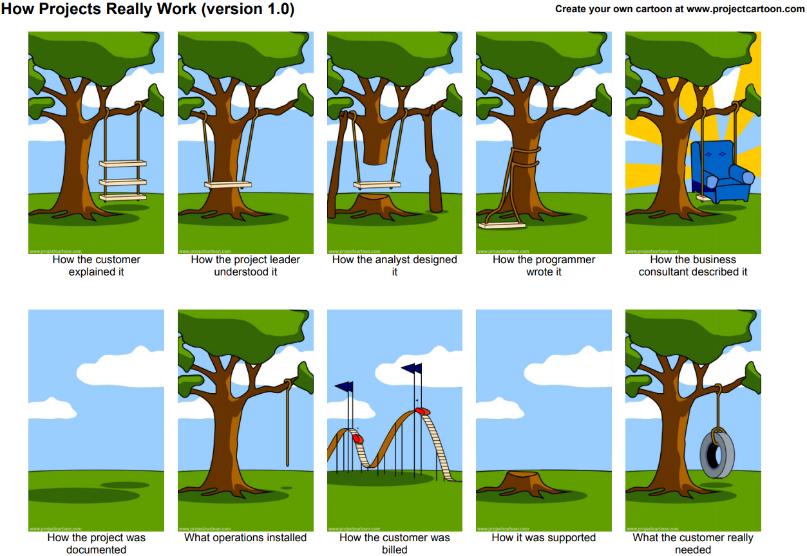

Slide 12
Programming is NOT enough!
It is not enough to do your best: you must know what to do, and THEN do your best.

Slide 13
A clever person solves a problem.
A wise person avoids it.
- Albert Einstein

Slide 14
What is Software?
When we write a program for computer we named it as software.
But software is not just a program; many things other than the program are also included in software. Some of the constituted items of software are described below.
Program: The program or code itself is definitely included in the software.
Data: The data on which the program operates is also considered as part of the software.
Documentation: Another very important thing that most of us forget is documentation. All the documents related to the software are also considered as part of the software.

Slide 15
Software Engineering
The application of a systematic, disciplined, quantifiable approach to the development, operation, and maintenance of software, the application of engineering to software.
The study of approaches as in (1).
IEEE Definition (1993)

Slide 16
Software Engineering
Objective is to produce software that is:
On time: is deliver at the established date.
Reliable: does not crash.
Complete: good documentation , fulfill customer needs.

Slide 17
Difference between Computer Science and Software Engineering
”This is the process of utilizing our knowledge of computer science in effective production of software systems.”

Slide 18
Difference between Software and Other Systems
“Software does not wear out!”

Slide 19
End of Lecture
Any Question?

